Slide 1

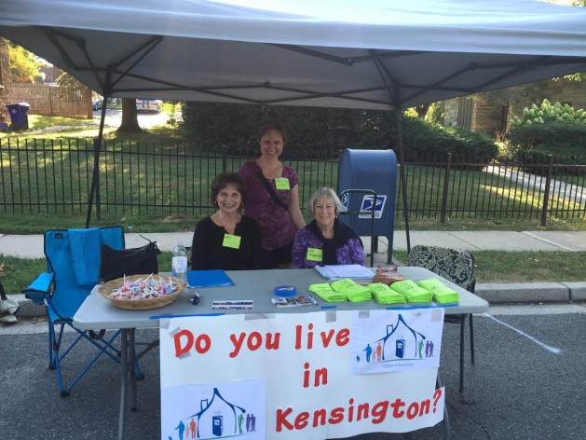
Presented by Suzanne Bowler, Ph.D.
With Rachel Gall and Arlene Horelick
(suzannebowler@verizon.net)
Notes:
The purpose of this presentation is to provide you with an overview of VoK, our mission, the progress we’ve made thus far toward opening for business early next year, and some of the services and social activities we’d like to offer our members, and communities as a whole.
We’ll begin with a brief description of what Villages are and why they’ve become so popular (answer Q why do we need a Village anyway), before talking about our own Village and then answering any questions or concerns you may have.
One important thing at start: if Parkwood decides they’d like to join us, we’ll give serious consideration to including the whole community—even that part’s that in the 20814 zip code.

Slide 2
To Learn More About Us:
See our website and Facebook:
www.villagesofkensingtonmd.org
https://www.facebook.com/KensingtonVillages
To contact any of our officers or Board members:
Go to our website and click on the “CONTACT US” tab.

Slide 3
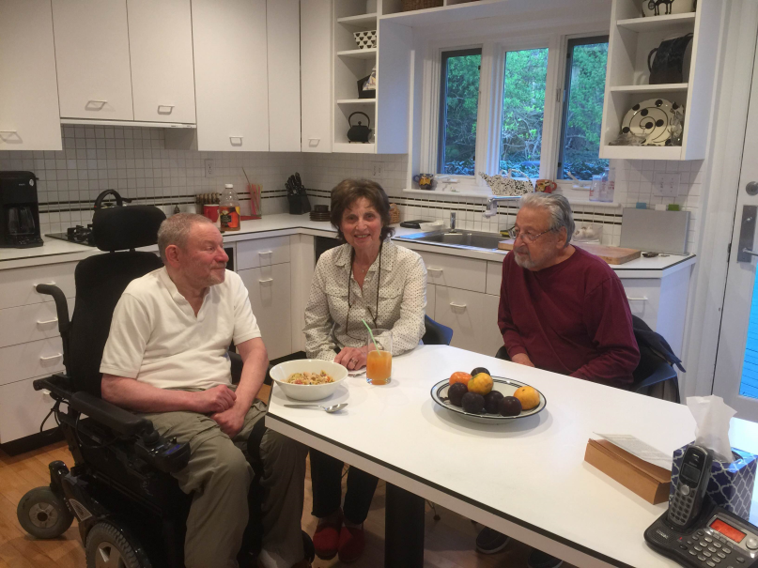
What is a Village?
Community grass-roots
Non-profit
Volunteer driven
Neighbors helping neighbors
Unique to each community’s needs
Range from 1 street to a whole county
Notes:
What’s the philosophy behind the concept of reality of villages?
They are unique because they are tailored to meet the specific needs of the community they serve.
This is the case in MD, where we have a 1-street village, villages covering zip codes, like SS, and other villages encompassing whole counties like Columbia and Howard County.

Slide 4
Villages become a Movement
Started in 2002 in Beacon Hill, Boston
Now: 150 nationwide, Netherlands, UK, and Australia.
Washington Area most prominent in country
MC has 23 Villages: only county w/Village Coordinator
Substantial support locally and nationally
Notes:
In our area, gold standards are Capitol Hill, and Chevy Chase at Home
In the Washington Metro Area, #s jumped from 5-40 between 2010 and 2015
MC is the only county nationwide with a Village Coordinator: Pazit Aviv who has given us tremendous help throughout our short history
--Local support: WAVE, local villages like SS and CH Chase at Home

Slide 5

Why are Villages so Popular?
Enable seniors to “age in place”
Get essential services and referrals
Make new friends-no longer alone
UC Berkeley study: substantial benefits
Notes:
--When no friends or relative to help them, many seniors end up in horrid nursing homes: assisted living too expensive; much happier in own homes where they’re more independent/in control
Recent report of old man starving; finally calls 911 for help—huge response.
Nationwide study sponsored by UC Berkeley School of Social Work: reducing social isolation (depression and poor health); enabling older members to stay longer in their homes & be more independent, increased engagement in social and educational activities—new friendships.
Example from SS: help I got changing our light bulbs in kitchen, shoveling our snow.
Found while members benefited, even more to volunteers – doing something useful/meaningful/making new friends.
Villages can also benefit younger people: e.g., for parents; pick up kids or take them to evening activities; bring home-cooked meals to give them a break—do grocery shopping or help children with homework.

Slide 6

Our Mission
Build and sustain a supportive, diverse, and intergenerational network of neighbors helping neighbors to be engaged in their community throughout their lives.
Our goal is to serve people of all ages in all Kensington communities.
Notes:
In other words, we aim to enhance the quality of life of VoK residents and communities as a whole: thus we offer not only services to assist people but also social and educational activities they’d like to have.
Younger residents also face many challenges and may not have friends or relatives living close by to help them with such things as the demands of child-raising and work, or if they live alone, providing assistance if they’re sick. I asked a lovely young woman with two children whether she’d like a home-cooked meal – she said “you bet” – tutoring, taking children to soccer games, piano lessons, etc. may be v. helpful.

Slide 7



VoK Services based on Preliminary Survey Results include:
Transportation
Computer/electronic assistance
Home maintenance/handyman services
Baby-sitting or after school care
Yard maintenance/snow shoveling
Notes:
To the docs, for errands/groceries, meetings, visiting friends, taking kids to after school activities

Slide 8

Social/Educational Activities based on Preliminary Survey Results Include:
Exercise, e.g., group walks
Lectures/classes
Book clubs/discussion groups
Social gatherings (e.g., coffees, lunches, potluck dinners)

Slide 9
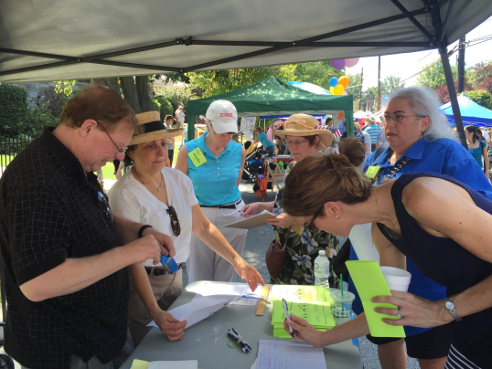
Progress toward Opening for Business
Formed a Steering Committee
Established Board of Directors with Officers
Finalized ByLaws
Gained 501c3 (non-profit) status
Exhibited at Day of the Book; Kensington Labor Day Festival
Notes:
We started in Sept. 2014 with a small meeting at my house in RCH. From then, we’ve grown into an organization representing 3 Kensington communities (RCH, KH, KG) along with other members from ToK, Parkwood, and RC Palisades) – eventually all of Kensington. We have 13 members
Partners currently include Seabury Resources for Aging, Kensington Park Senior Community, Crossways/Montessori School, Temple Emmanuel – PLANS ARE TO CONTINUE OUTREACH TO RELIGIOUS, SOCIAL SERVICES, AND BUSINESS ORGANIZATIONS TO ESTABLISH MUTUALLY BENEFICIAL RELATIONSHIPS
--Civic Associations: KH, here tonight, RCHCA, and Chevy Chase View
--Other work includes developing brochures for distribution at local events like tonight.

Slide 10
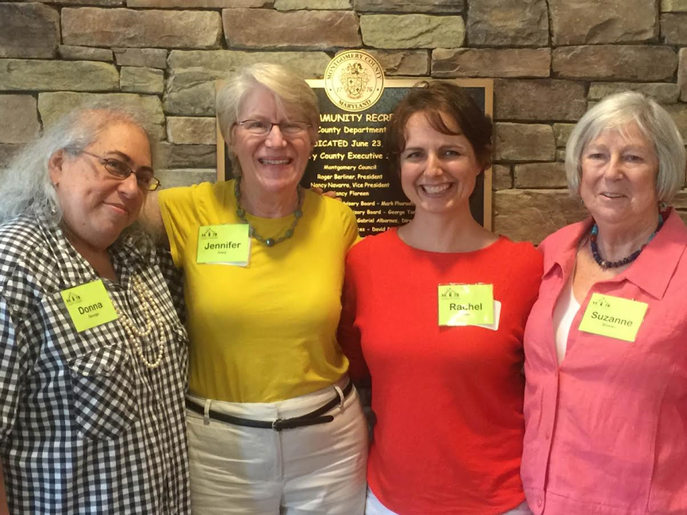
Other Accomplishments
Formed partnerships
Attended Village Gatherings
50+ Kensington residents ready to volunteer
Plan to open next Spring/early Summer
Notes:
With local organizations: Seabury Resources for Aging, Crossway Montessori School, Temple Emmanuel, JSSA and will businesses, local hospitals and rehab centers as well as churches
GROWS is an organization of service providers for seniors

Slide 11

Questions & Answers

Slide 12

Come and Join Us!
We’d love to have you in our Village and share its benefits with you
Parkwood would be an invaluable addition to our Village
We’ll keep you updated on our progress
Notes:
Parkwood would be wonderful addition to our Village.

Slide 13
To Learn More About Us:
See our website and Facebook:
www.villagesofkensingtonmd.org
https://www.facebook.com/KensingtonVillages
To contact any of our officers or Board members:
Go to our website and click on the “CONTACT US” tab.

